Slide 1


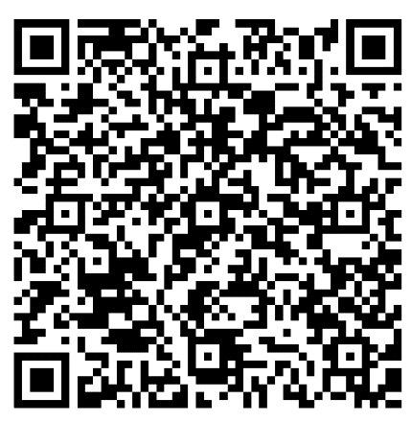
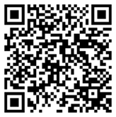
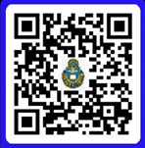
Sermon Notes
Hebrews 4: 14-5:10
__________________________________________________________________________________________________________________________________________________________________________________________________________________
______________________________
CHAPEL OUTREACH: We would like to thank the Men of the Chapel and CrossRoads for their Outreach on Thursday mornings at Lewis and Clark’s food court. If you were invited from the Men of the Chapel, please let a chaplain know. We want to welcome you!!
“THE BETTER RACE” Run Club: As we study through the book of Hebrews about the “race marked out of us,” join us on Saturday mornings at 7am, Frontier Chapel, for prayer, a brief devotional, and a run (all abilities and paces welcome)! POC: Amanda Vineyard, Cell: 931-561-8753.
DATE NIGHT: Join us for the next
Vertical Marriage Date Night on
13 March. Scan the QR code or
call Jeff at 910-644-2999.
15 February 2026
It is our desire to connect with you and help you grow in Christ during your time at Fort Leavenworth. Scan the QR code and let’s grow together.
Order of Worship
BRING IN
Welcome & Announcements
Preparation for Worship
Call to Worship
BUILD UP
Worship through Singing
Worship through Giving*
Worship through the Reading and Preaching of God’s Word
Worship through Communion**
SEND OUT
Worship through Reflection and Response
Benediction
Fellowship
*Children released to children’s church after the offering is complete except for the 1st Sunday.
** The first Sunday every month.
Announcements
ADULT & CHILDREN’S SUNDAY SCHOOL 0945-1045.
Pioneer and Frontier Chapel classrooms, see foyer for class information. POC: Carl Tillery (Sunday School teachers needed, please help us make disciples!)
OFFICERS’ CHRISTIAN FELLOWSHIP: meets at Pioneer Chapel at 6am on Tuesday. POC: Jim Harbridge at leavenworth@ocfusa.org
FINANCIAL PEACE: Frontier Chapel, every Sunday from 1-3, room 158. POC: Zach at zjmundell@gmail.com
FAMILY NIGHT: Frontier Chapel, 22 February, at 5:30pm. Pizza, Praise, & Play for the whole family.
POC: Amanda at vineyards629@yahoo.com
QR for Digital Giving
Checks: DACH CTOF – USAG Fort Leavenworth on the “TO” line
Crossroads Staff
Sr. Pastor: CH Jared Vineyard - jared.l.vineyard.mil@army.mil
Education: Carl Tillery – carl.l.tillery.civ@army.mil
Music: CH Joshua Portwood joshua.m.portwood.mil@army.mil
Youth: Samantha Odle - sodle@yfc.net
Facebook: Search ‘Crossroads Protestant Chapel’
Website: https://www.fortleavenworthchapel.org/

