Slide 1



Slide 2
ROOTED | EMPOWERED
EPHESIANS 6:10-17
CH Jared Vineyard
16 November 2025
BUILD UP
CROSSROADS CHAPEL

Slide 3

GREENING
OF THE CHAPELS
Saturday 22 November 0900
Pioneer & Frontier Chapels
Pizza Served Afterward

Slide 4

Tuesday
25 November, 1700
Pioneer Chapel
Pie Fellowship following
(Provided by PWOC)

Slide 5

Wednesday Evenings 1300-1500
Begins 23 November
Room 158, Frontier Chapel
POC: Zach Mundell, zjmundell@gmail.com

Slide 6

VOLUNTEERS NEEDED TO PROVIDE
FRUIT OR DESSERT
2ND SATURDAY OF EACH MONTH
POC: LINDA FARWELL, 913-547-5018 farwelllinda@gmail.com

Slide 7


Slide 8



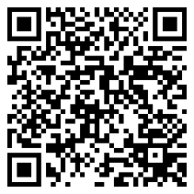

Meals &
Childcare provided
Invest in your marriage!
Join us for a monthly
DATE NIGHT
08 AUG, 05 SEP, 10 OCT, 07 NOV, 05 DEC,
Supported by
For more information and to register scan the QR code or call 910-644-2999
For more information and to register, scan the QR code or call/text 910-644-2999

Slide 9
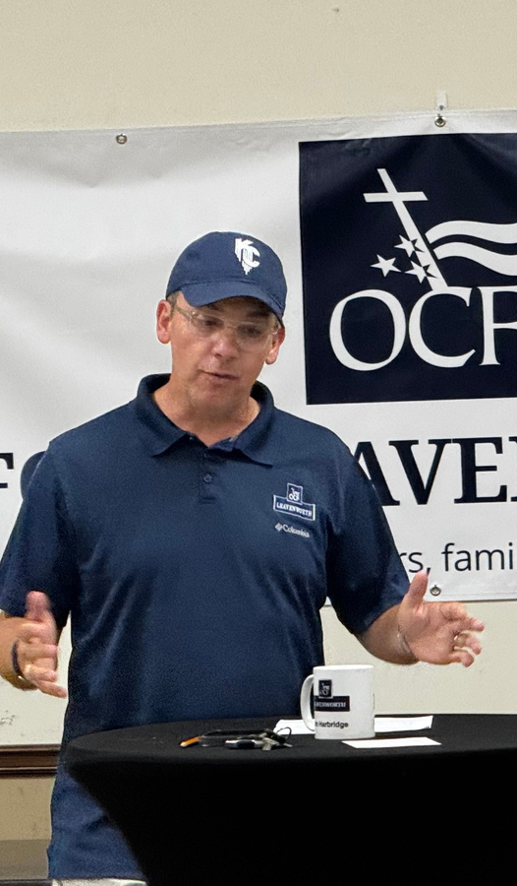
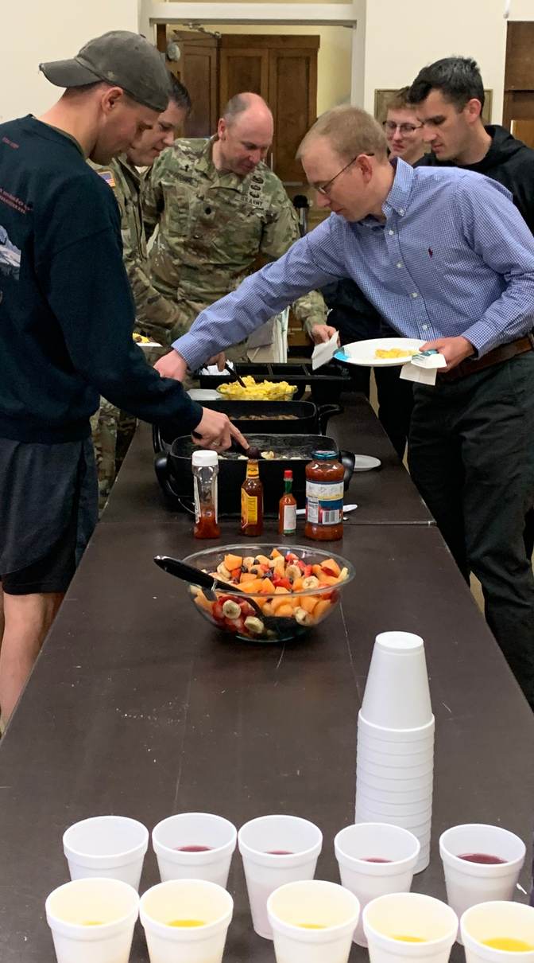
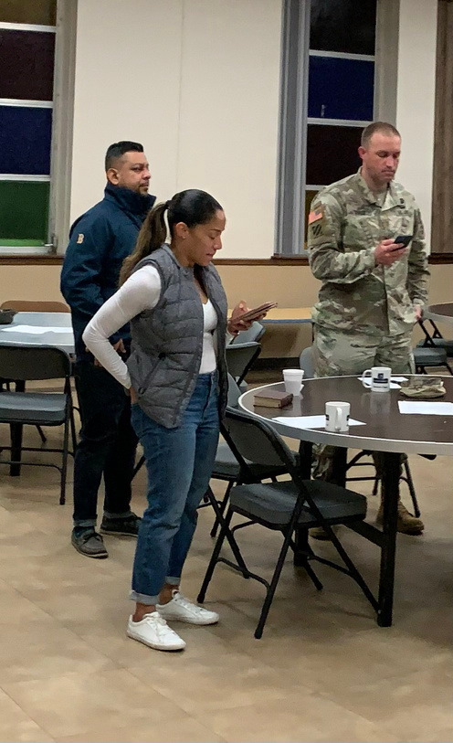
Discipleship Training Breakfast
A YEAR LONG TOPICAL BIBLE STUDY & BREAKFAST FOCUSED ON INTEGRATING FAITH IN CHRIST INTO ALL DOMAINS OF OUR LIVES (PERSONAL DEVELOPMENT, FAMILY, PROFESSION, AND COMMUNITY)
0600-0730 EVERY TUESDAY IN PIONEER CHAPEL

Slide 10

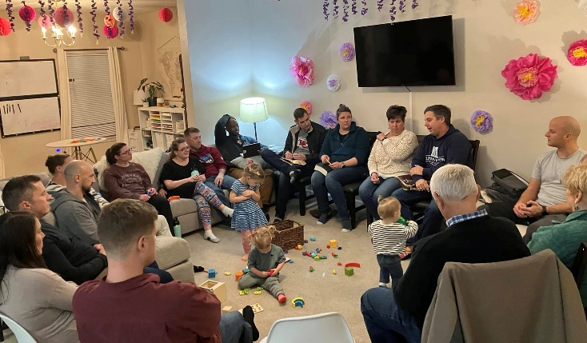
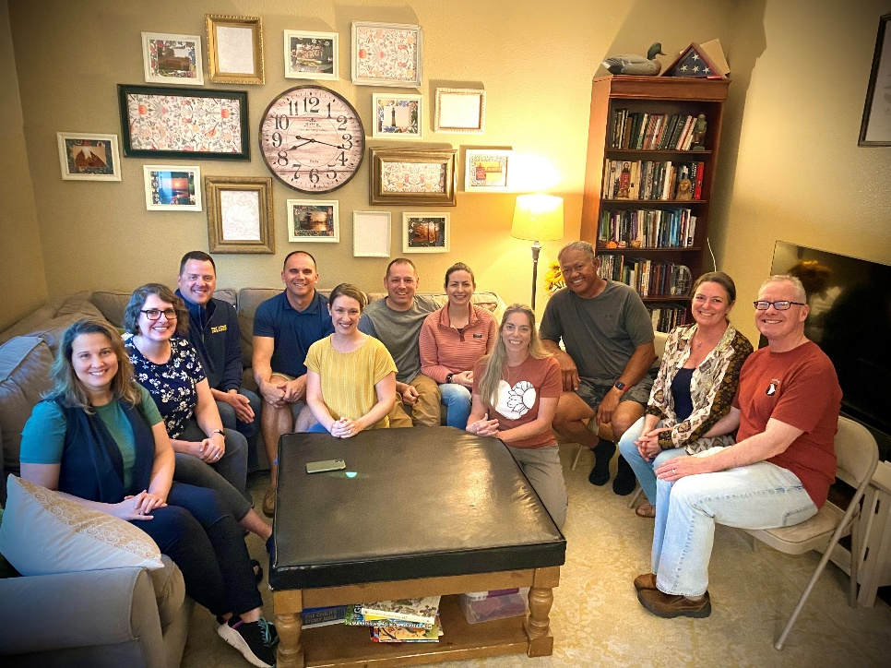
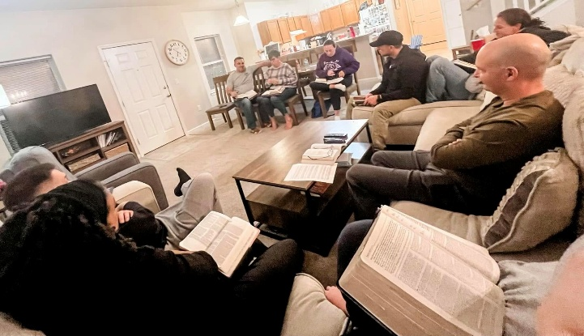
Crossroads’ Neighborhood
Bible Study Groups
Acts 2:42
“And they devoted themselves to the apostles’ teaching
and the fellowship, to the breaking of bread and Prayer.”
Experience Christian Community!
Biblical Fellowship
Encouragement
Bible Study
Prayer
Fun!
Host a Group!
Leader Care
Facilitator Training
Mentorship & Discipleship
Sign-Up Sheet in Fellowship Hall or contact Jim Harbridge at leavenworth@ocfusa.org

Slide 11
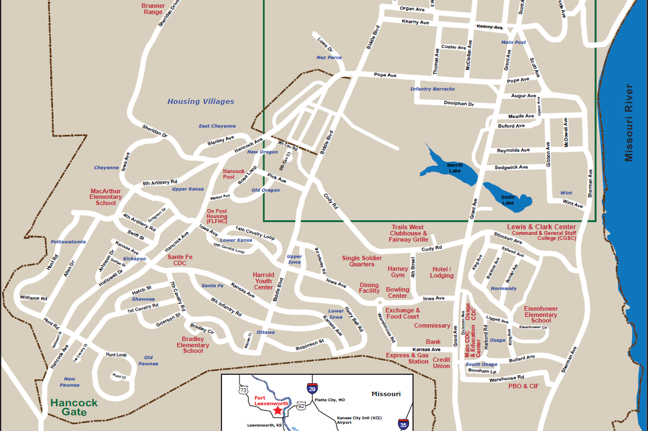
15 Neighborhoods on Post!
Main Post
Nez Perce
Cheyenne
Oregon
Wint
Kansa
Pottawatomie
Kickapoo
Santa Fe
Normandy
Iowa
Shawnee
Ottawa
Osage
Pawnee
Sign-Up Sheet in Fellowship Hall or contact Jim Harbridge at leavenworth@ocfusa.org

Slide 12

Adult Class 1 - “The Knowledge of the Holy,” Room 158
Adult Class 2 - “Philippians: Christ, the Source of Joy and Strength”
Adult Class 3 - The Book of 1 John, Room 150A
Adult Class 4 - “The Power of a Praying Parent,” Room 122
Young Adult Class - “Christian Beliefs”, Room 150
4 & 5 year olds Pioneer Chapel, Room 132
1st & 2nd grade Pioneer Chapel, Room 133
3rd & 4th grade Pioneer Chapel, Room 121
5th & 6th grade Pioneer Chapel, Room 119
7th & 8th grade Pioneer Chapel, Room 118
9th -12th grade Pioneer Chapel, Room 120

Slide 13

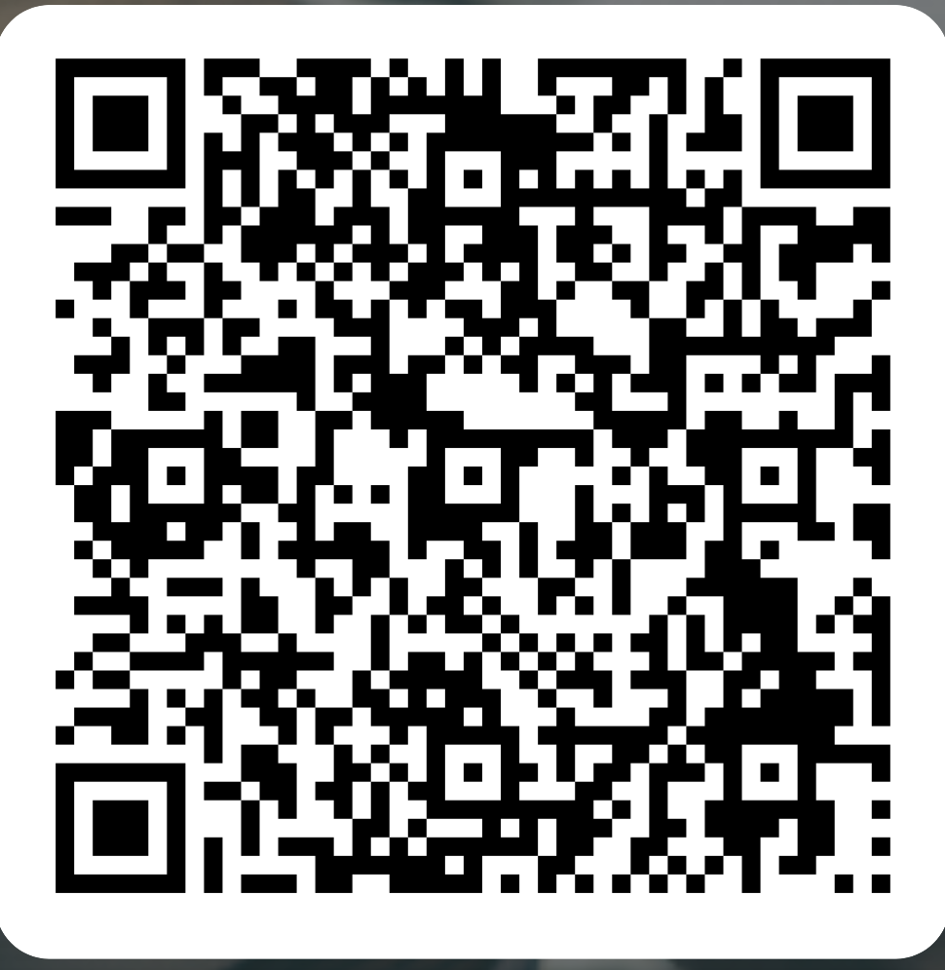

Slide 14
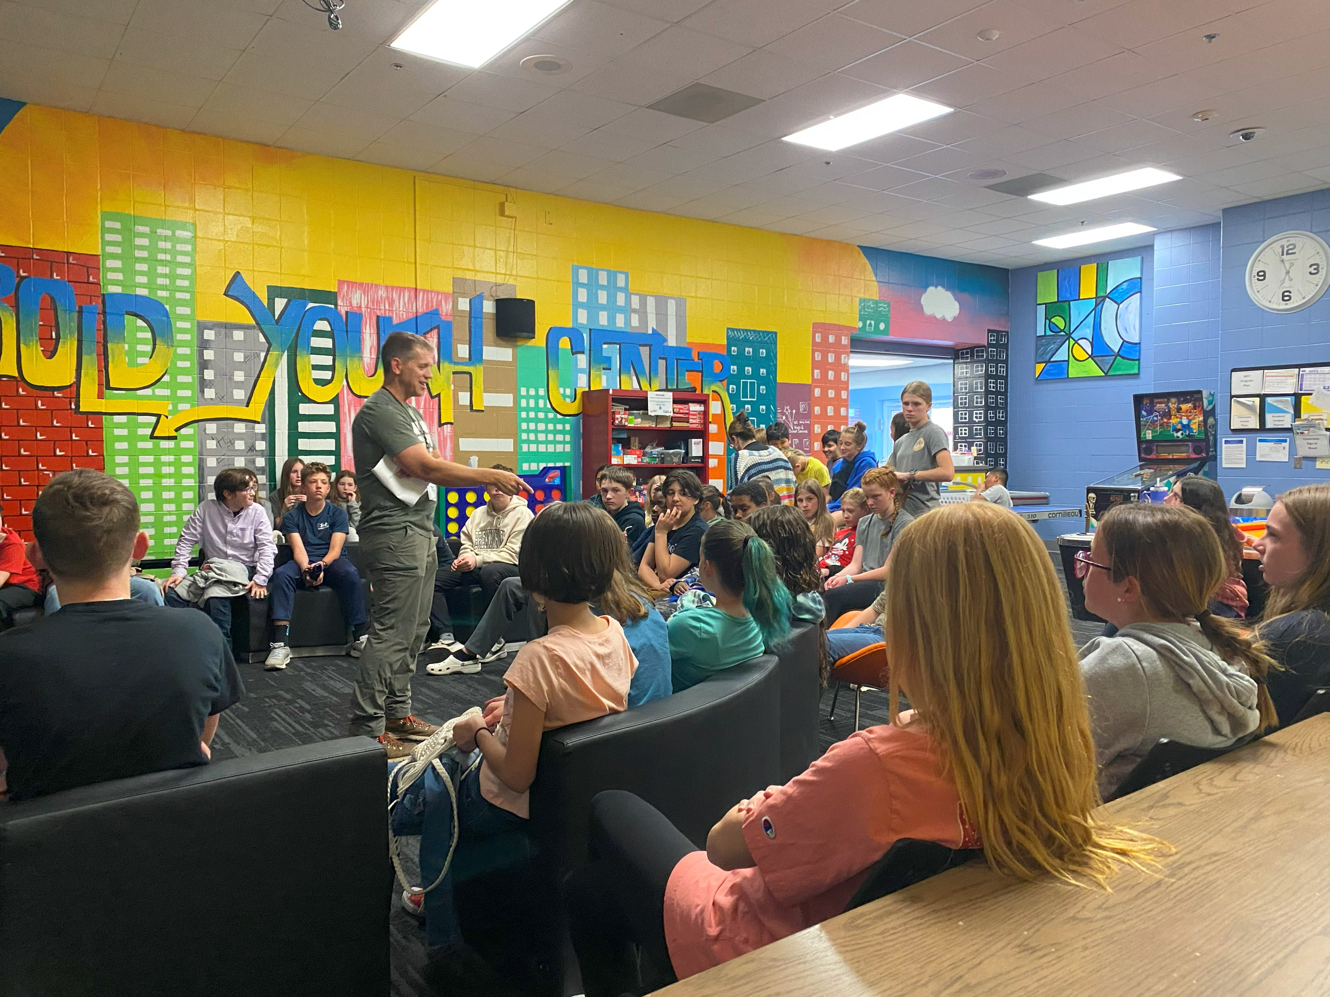
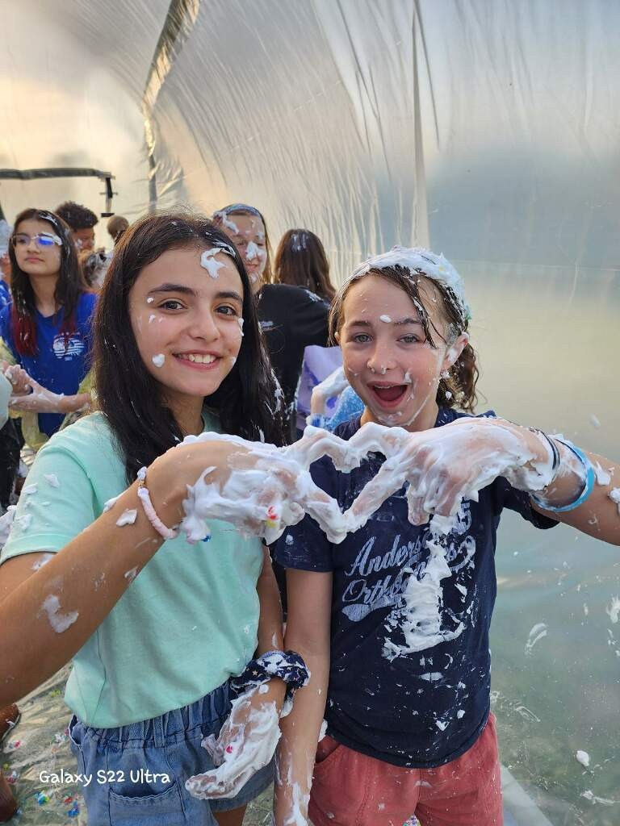
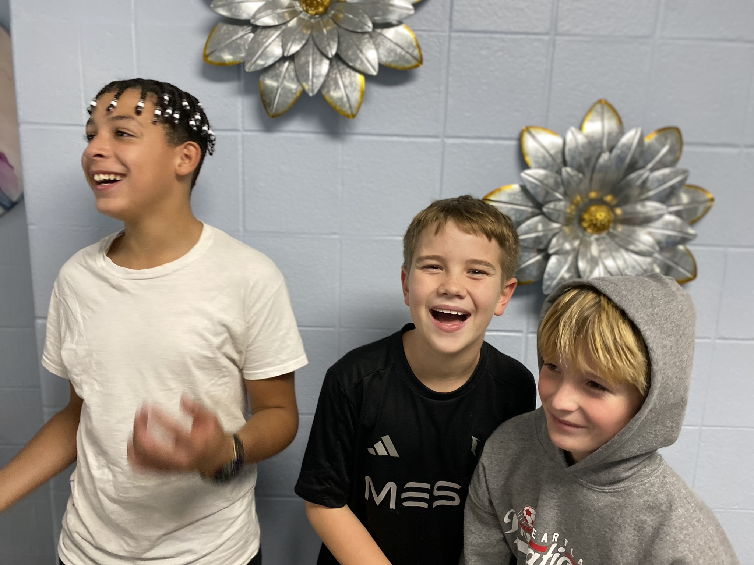
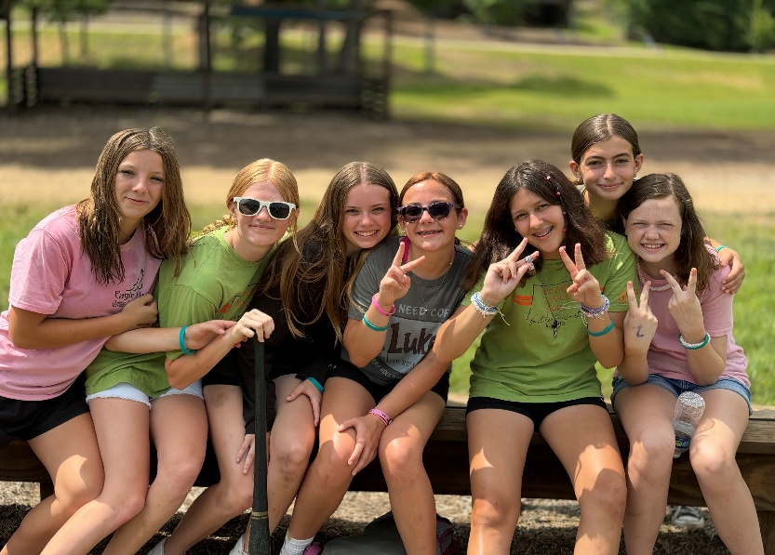
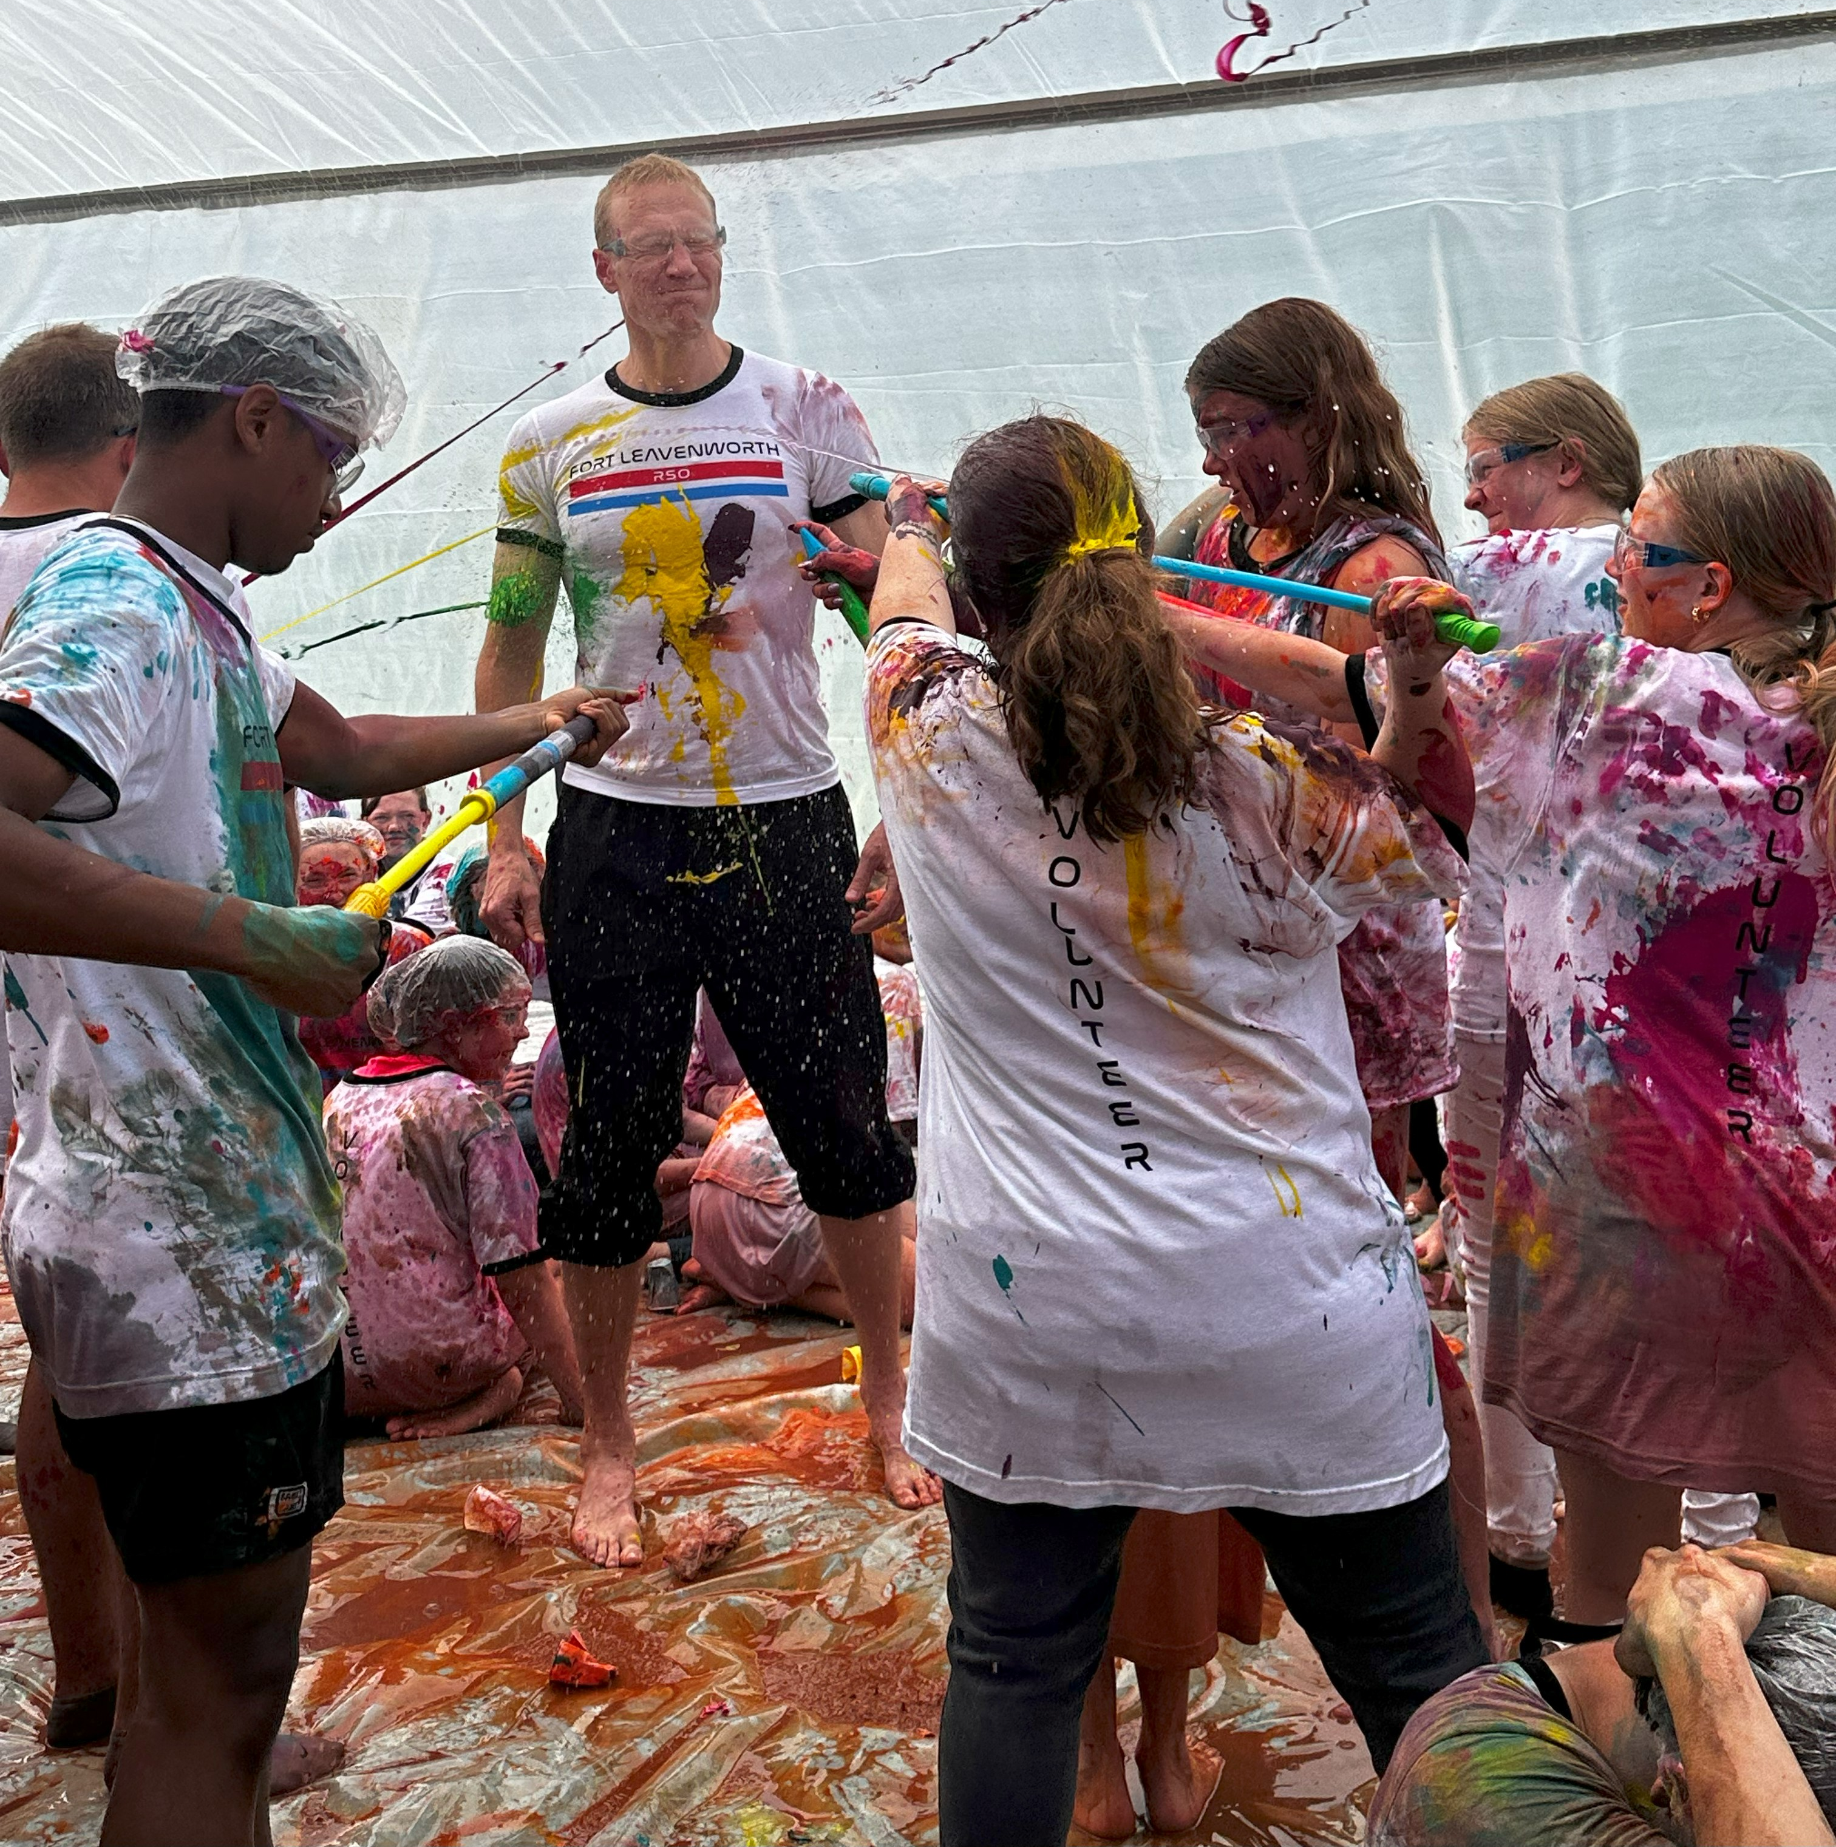


CAMPUS LIFE MILITARY
SHARING AND CONNECTING WITH GOD’S STORY • BUILDING AUTHENTIC, CHRIST-SHARING RELATIONSHIPS
CLUB
TUESDAYS FROM 1800 –1930
HARROLD YOUTH CENTER
SMALL GROUPS
THURSDAYS, TIMES MAY VARY
PIONEER CHAPEL
*BEGINNING SEPTEMBER 18*
POC: SAMANTHA ODLE
(605) 569-3820
SODLE@YFC.NET
FT. LEAVENWORTH CAMPUS LIFE MILITARY
@CAMPUSLIFEFORTLEAVENWORTH

Slide 15
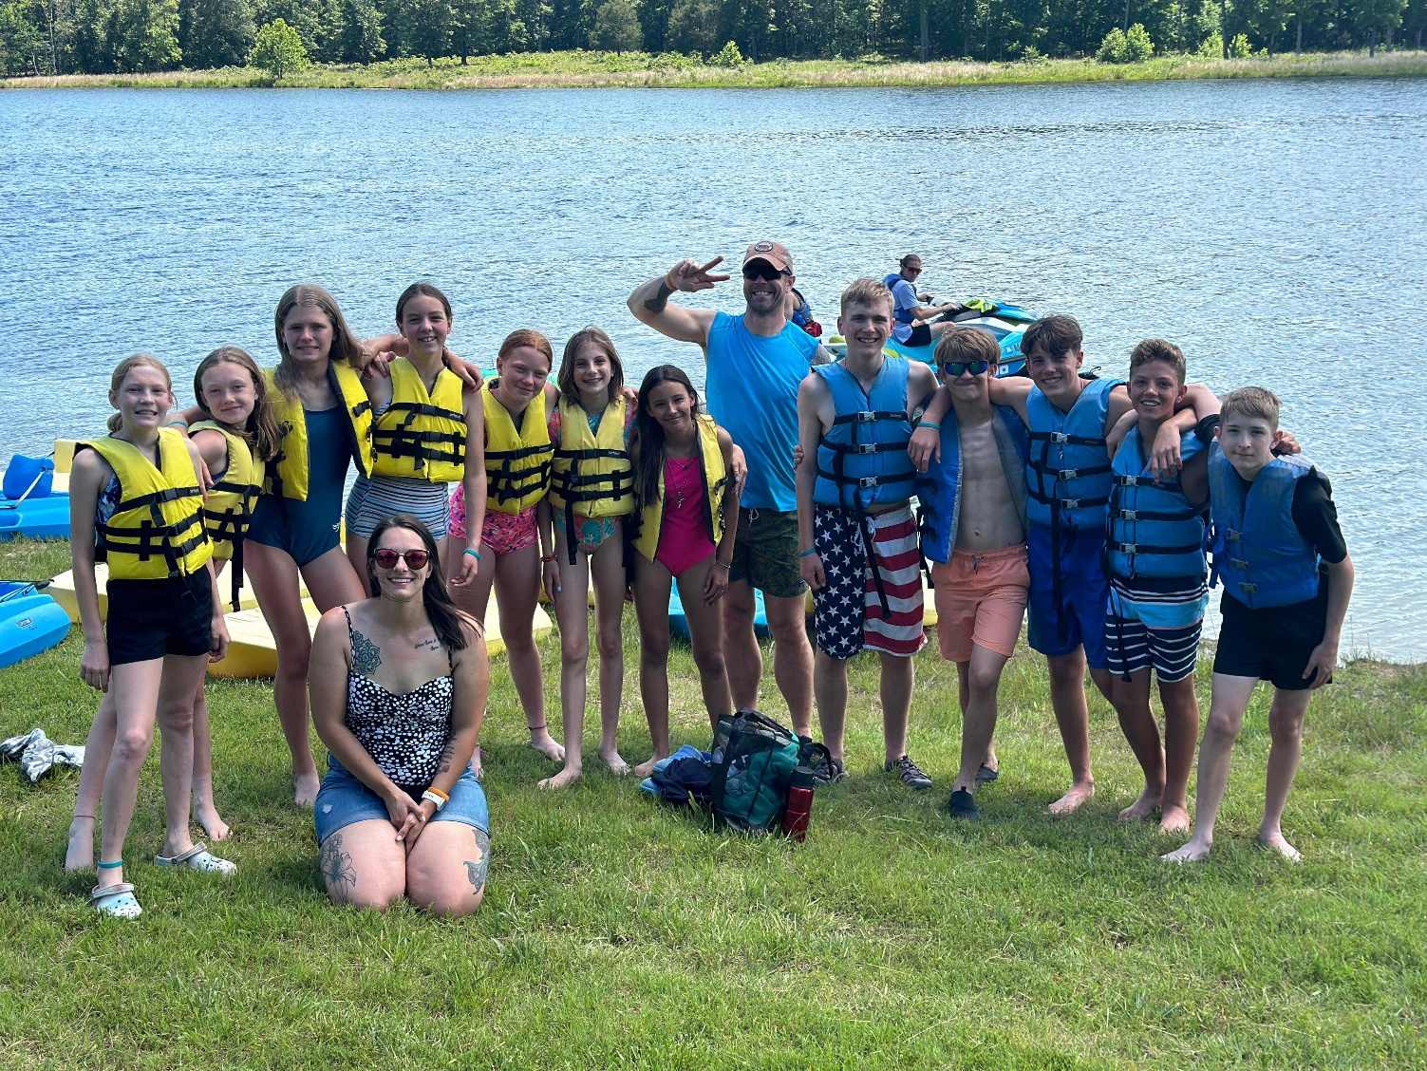
VOLUNTEER OPPORTUNITIES
CLUB VOLUNTEER
SMALL GROUP LEADER
ACTIVITY / EVENT SUPPORT
PRAYER SUPPORT TEAM
FINANCIAL SUPPORT TEAM
SPIRITUAL SUPPORT TEAM
POC: SAMANTHA ODLE
(605) 569-3820
SODLE@YFC.NET
FT. LEAVENWORTH CAMPUS LIFE MILITARY
@CAMPUSLIFEFORTLEAVENWORTH

Slide 16

Room 158, Frontier Chapel
Questions? Contact Jim Harbridge
leavenworth@ocfusa.org
ADULT SUNDAY SCHOOL
‘The Knowledge of the Holy’
“The Knowledge of the Holy” by beloved Christian author A.W. Tozer illuminates God’s attributes—from wisdom, to grace, to mercy—and aides to restore the majesty and wonder of God in the hearts and minds of all Christians.”

Slide 17

Room 122, Frontier Chapel
Questions? Contact Amanda Vineyard
vineyards629@yahoo.com
ADULT SUNDAY SCHOOL
‘The Power of a Praying Parent’
Learn how to pray scripture over our children and fight the battle for their hearts in prayer

Slide 18

YOUNG ADULT SUNDAY SCHOOL
‘Christian Beliefs-20 Basics Every Christian Should Know’
Room 150B, Frontier Chapel
Questions? Contact Jeff Smith
chsmithc4@gmail.com
Learn
About the Bible
The characteristics of God
What it means that we are created in the image of God
What God has done for us in Christ
The purpose of the church
and much more.

Slide 19

ADULT SUNDAY SCHOOL
Philippians
Philippians
Christ, The Source of Joy and Strength
Explore Paul’s teachings on the
dangers of self-sufficiency and complacency.
Beginning Sunday 14 September 2025
Room 153, Frontier Chapel
and Zoom 848 5837 0306 at 0945
Questions? Dr. Dean Nowowiejski

Slide 20
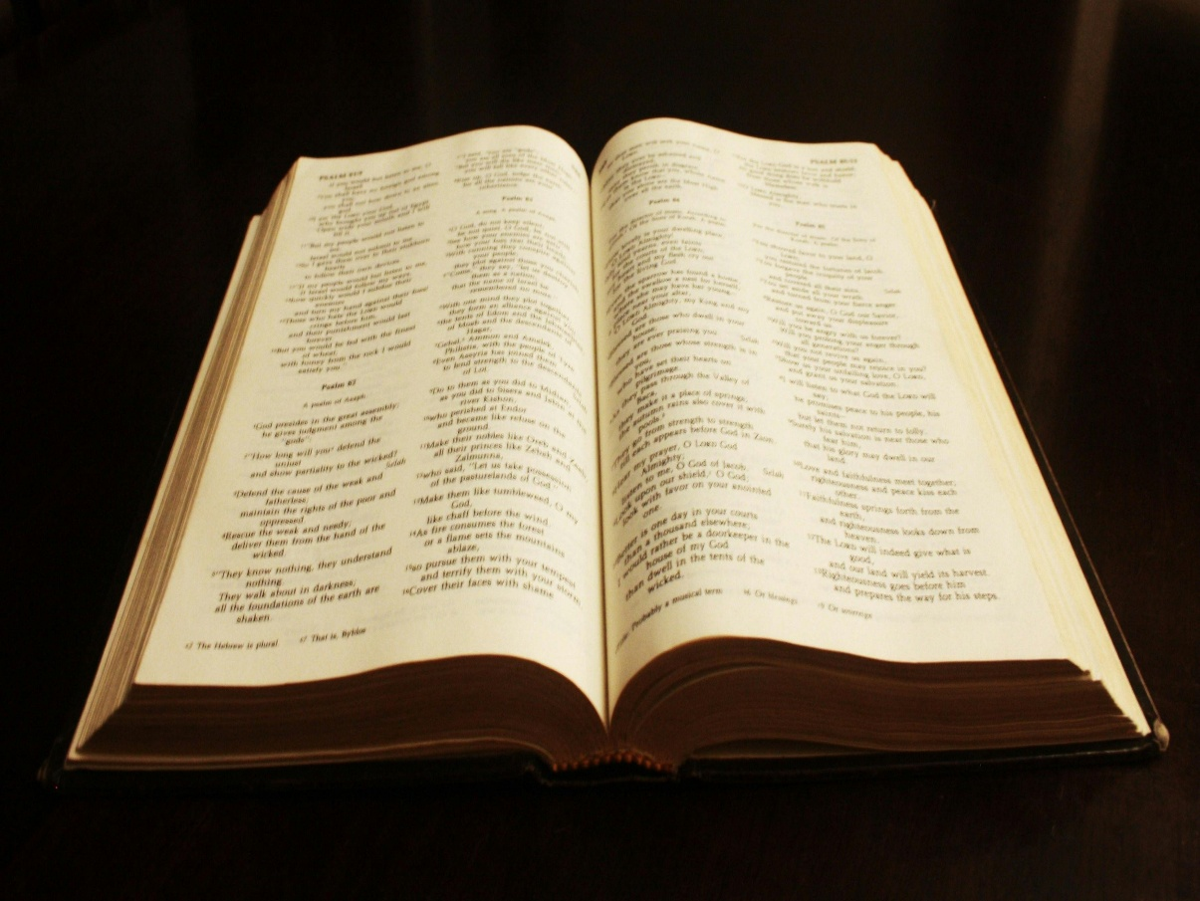
Room 150, Frontier Chapel
Questions? Contact Randy Klinger
randy_klinger@yahoo.com
ADULT SUNDAY SCHOOL
1 John
The Book of 1 John

Slide 21



DIGITAL GIVING
.

