Slide 4
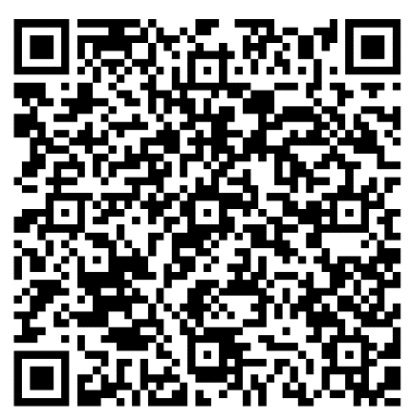
CROSSROADS
PROTESTANT COMMUNITY
STAY CONNECTED!
Scan the QR Code below

Slide 5
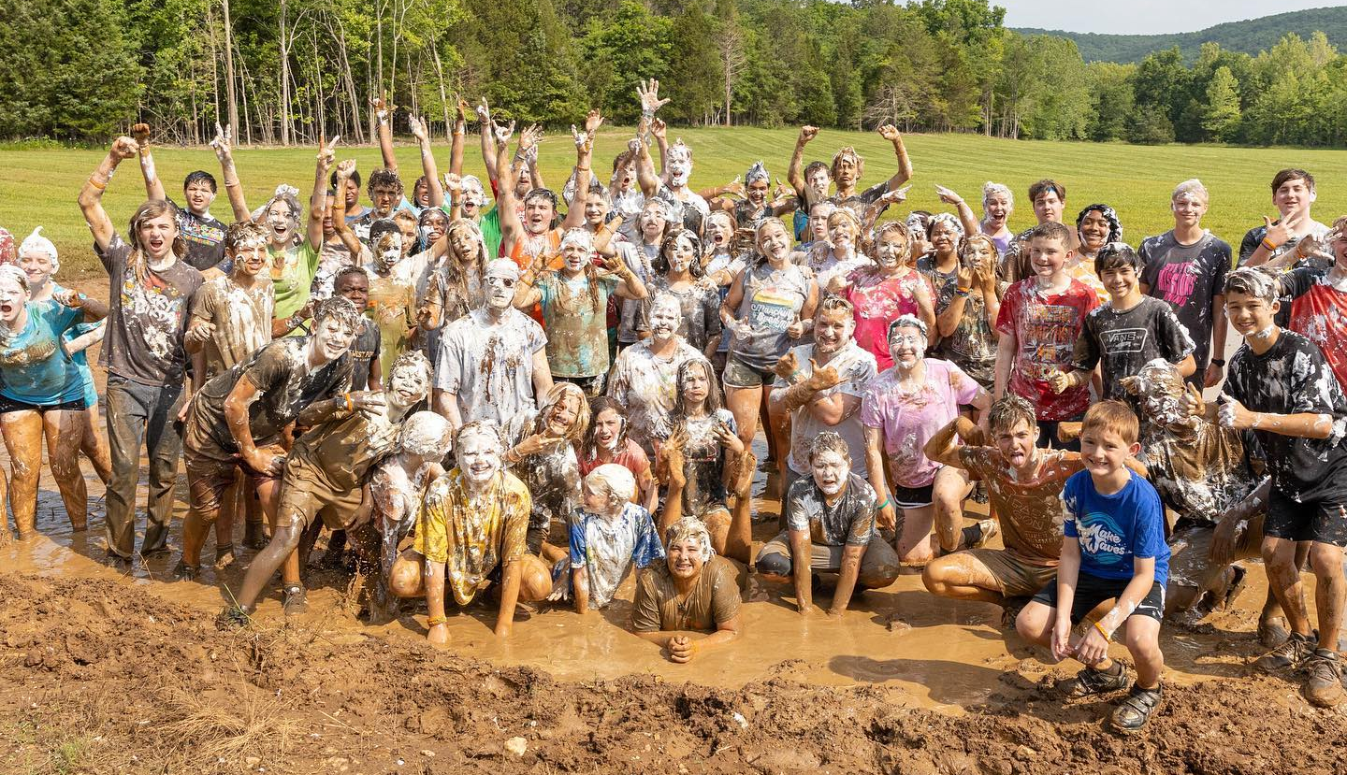
Campus Life Military
Sharing and connecting with God’s story
Building authentic, Christ-sharing relationships
Who: 6th-12th Grade
When: Wednesdays from 1830-1945
Where: Harrold Youth Center
POC: Samantha Odle
(605) 569-3820
sodle@yfc.net
Ft. Leavenworth Club – Campus Life Military
@campuslifefortleavenworth

Slide 6
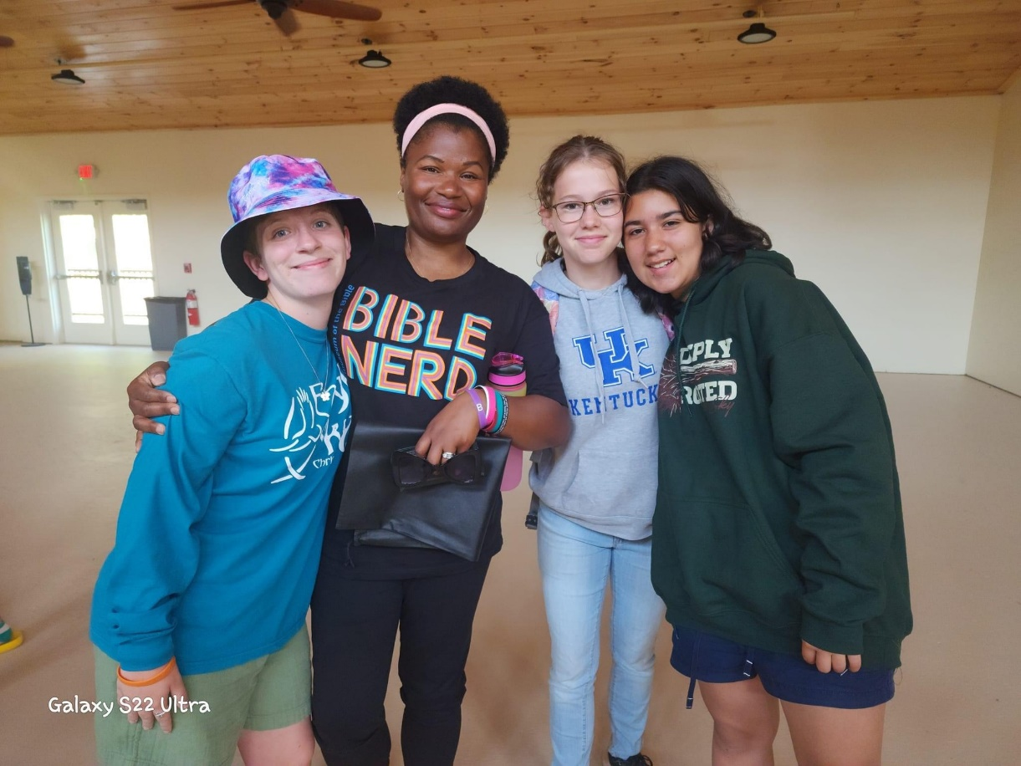
Seeking Volunteers
Campus Life Military needs volunteers who love military youth and want to create authentic, Christ-sharing relationships.
Ministry Opportunities:
(Included, but not limited to)
Club volunteer
Small group leader
Activity / event support
Driver for off-post events
Prayer support team
Financial support team
Spiritual support team
POC: Samantha Odle
(605) 569-3820
sodle@yfc.net

Slide 8
ADULT SUNDAY SCHOOL
That the World May Know, Volume 7 With Ray Vander Laan
Walk as Jesus Walked: Being a Disciple in a Broken World
Come discover the fierce passion of our early Christian brothers and sisters to walk like Jesus—even when the path became treacherous
Filmed on location in Turkey
Beginning Sunday 7 April 2024
Room 153, Frontier Chapel and on Zoom at 1000
Questions? Dr. Dean Nowowiejski

Slide 9
ADULT SUNDAY SCHOOL
EZRA & NEHEMIAH
Discover God's mercy and faithfulness in Ezra and Nehemiah
Room 158, Frontier Chapel, 0945

Slide 10
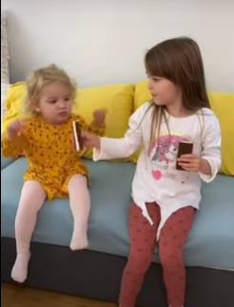
ADULT SUNDAY SCHOOL
BEGINS 7 JANUARY
Randy and Linda Klinger
Room 150, 0945-1045
Alpha Video Series

Slide 11
DIGITAL GIVING
.

