Slide 1


Slide 2
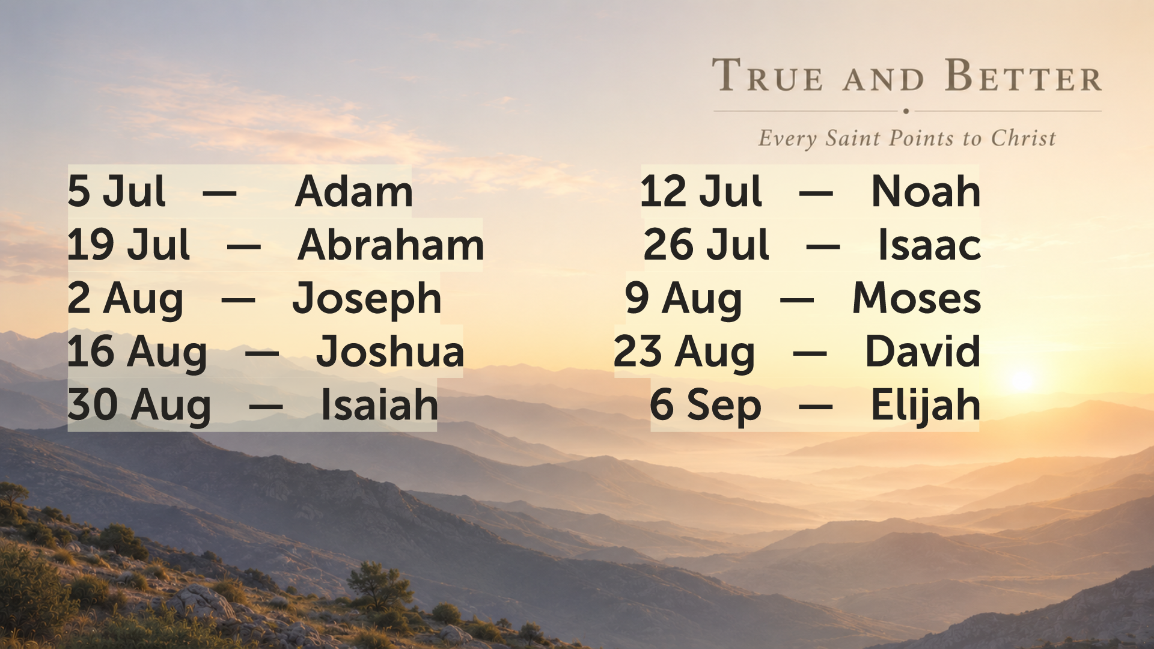

Slide 3

apl
JOSEPH
Genesis 45: 1-15
Chaplain Seth George
2 August 2026

Slide 5


Slide 6


Slide 7


Slide 8


Slide 9


Slide 10


Slide 11


Slide 12


Slide 13


Slide 14


Slide 15


Slide 16


Slide 17


