Slide 1


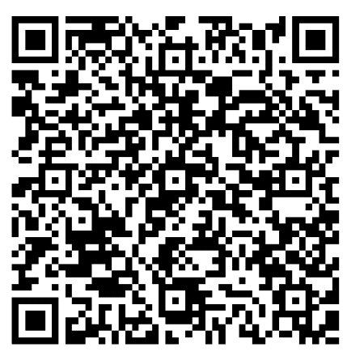
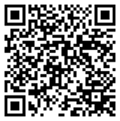
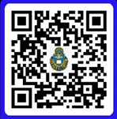
Sermon Notes
Matthew 28
__________________________________________________________________________________________________________________________________________________________________________________________________________________
________________________________________________________________________________________________________________________
“THE BETTER RACE” Run Club: We will have the Better Race on Saturday, 09 May, at 0800 around Frontier Chapel. POC: Amanda Vineyard, Cell: 931-561-8753.
NEW BELIEVERS CLASS: Please see a chaplain or Carl Tillery for more information.
DATE NIGHT: Join us for the next
Vertical Marriage Date Night on
10 April. Scan the QR code or
call Jeff at 910-644-2999.
05 April 2026
It is our desire to connect with you and help you grow in Christ during your time at Fort Leavenworth. Scan the QR code and let’s grow together.
Order of Worship
BRING IN
Welcome & Announcements
Preparation for Worship
Call to Worship
BUILD UP
Worship through Singing
Worship through Giving*
Worship through the Reading and Preaching of God’s Word
Worship through Communion**
SEND OUT
Worship through Reflection and Response
Benediction
Fellowship
*Children released to children’s church after the offering is complete except for the 1st Sunday.
** The first Sunday every month.
Announcements
OFFICERS’ CHRISTIAN FELLOWSHIP: meets at Pioneer Chapel at 6am on Tuesday. POC: Jim Harbridge at leavenworth@ocfusa.org
FAMILY NIGHT: Frontier Chapel, 26 April, at 5:30pm. Pizza, Praise, & Play for the whole family.
POC: Amanda at vineyards629@yahoo.com
DESIGNATED OFFERING: We will take a D.O. on 12 April for the Leavenworth Officers’ Christian Fellowship.
QR for Digital Giving
Checks: DACH CTOF – USAG Fort Leavenworth on the “TO” line
Crossroads Staff
Sr. Pastor: CH Jared Vineyard - jared.l.vineyard.mil@army.mil
Education: Carl Tillery – carl.l.tillery.civ@army.mil
Music: CH Joshua Portwood joshua.m.portwood.mil@army.mil
Youth: Samantha Odle - sodle@yfc.net
Facebook: Search ‘Crossroads Protestant Chapel’
Website: https://www.fortleavenworthchapel.org/

