Slide 1


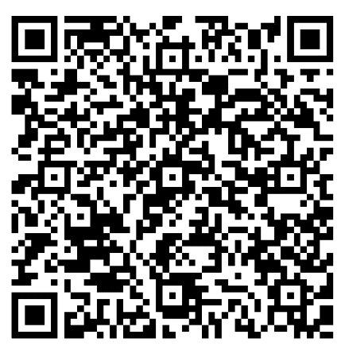
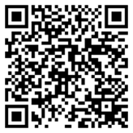
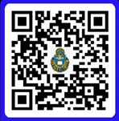
Sermon Notes
Hebrews 9: 1-14
__________________________________________________________________________________________________________________________________________________________________________________________________________________
______________________________
“THE BETTER RACE” Run Club: As we study through the book of Hebrews about the “race marked out of us,” join us on Saturday mornings at 7am, Frontier Chapel, for prayer, a brief devotional, and a run (all abilities and paces welcome)! POC: Amanda Vineyard, Cell: 931-561-8753.
NEW BELIEVERS CLASS: Will start on 22 March. Please see a chaplain or Carl Tillery for more information.
DATE NIGHT: Join us for the next
Vertical Marriage Date Night on
10 April. Scan the QR code or
call Jeff at 910-644-2999.
15 March 2026
It is our desire to connect with you and help you grow in Christ during your time at Fort Leavenworth. Scan the QR code and let’s grow together.
Order of Worship
BRING IN
Welcome & Announcements
Preparation for Worship
Call to Worship
BUILD UP
Worship through Singing
Worship through Giving*
Worship through the Reading and Preaching of God’s Word
Worship through Communion**
SEND OUT
Worship through Reflection and Response
Benediction
Fellowship
*Children released to children’s church after the offering is complete except for the 1st Sunday.
** The first Sunday every month.
Announcements
EASTER EGG HUNT: CrossRoads will hold an Easter Egg Hunt on 29 March (Sunday) at 10am outside Pioneer Chapel.
EASTER SERVICES: Good Friday Service (03 April) inside Memorial Chapel at 3pm; Easter Sunrise Service (05 April) at Memorial Chapel at 7am.
OFFICERS’ CHRISTIAN FELLOWSHIP: meets at Pioneer Chapel at 6am on Tuesday. POC: Jim Harbridge at leavenworth@ocfusa.org
FAMILY NIGHT: Frontier Chapel, 29 March, at 5:30pm. Pizza, Praise, & Play for the whole family.
POC: Amanda at vineyards629@yahoo.com
QR for Digital Giving
Checks: DACH CTOF – USAG Fort Leavenworth on the “TO” line
Crossroads Staff
Sr. Pastor: CH Jared Vineyard - jared.l.vineyard.mil@army.mil
Education: Carl Tillery – carl.l.tillery.civ@army.mil
Music: CH Joshua Portwood joshua.m.portwood.mil@army.mil
Youth: Samantha Odle - sodle@yfc.net
Facebook: Search ‘Crossroads Protestant Chapel’
Website: https://www.fortleavenworthchapel.org/

