Slide 1

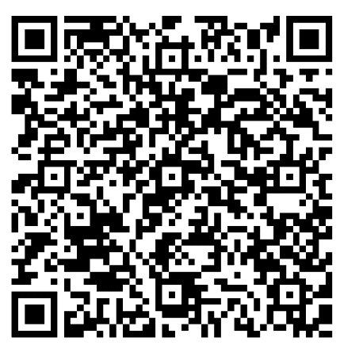
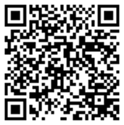
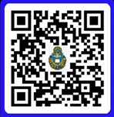
Sermon Notes
__________________________________________________________________________________________________________________________________________________________________________________________________________________
***SUNDAY SCHOOL TEACHERS NEEDED:
We need additional Sunday school teachers for 1-2 and 3-4 grades. Please see Carl Tillery.
DATE NIGHT: Commit to making your marriage a priority. Join us for the next Vertical Marriage Date Night on 05 December. Scan the QR code or call Jeff at 910-644-2999 for more information.
“TO GLORIFY GOD”
BRING IN | BUILD UP | SEND OUT
Ephesians 6: 18-24
23 November 2025
WELCOME TO CROSSROADS
It is our desire to connect with you and help you grow in Christ during your time at Fort Leavenworth. Scan the QR code and let’s grow together.
ADULT & CHILDREN’S SUNDAY SCHOOL 0945-1045.
Adult Class 1: Knowledge of the Holy, A.W.Tozer. Frontier Chapel, Room 158. Taught by Jim Harbridge.
Adult Class 2: Philippians: Christ, the Source of Joy and Strength. Frontier Chapel Rm 153 or Zoom Meeting ID 848 5837 0306. Paul urges believers to maintain their spiritual commitment and integrity and to continue to grow in Christ. Taught by Dr. Dean Nowowiejski
Adult Class 3: Book of 1 John, Room 150A, Frontier Chapel. Taught by Randy Klinger.
Adult Class 4: Power of a Praying Parent, Room 122, Frontier Chapel. Let’s learn how to pray scripture over our children and fight the battle for their hearts in prayer. Taught by Amanda Vineyard.
Young Adults: Christian Beliefs: 20 Basics Every Christian Should Know, by Wayne Grudem. Room 150B Frontier Chapel. Taught by Jeff Smith.
DESIGNATED OFFERING: Designated offering on 23 November for Samaritan’s Purse
PWOC: Tuesday from 0830-1100 and 6:30-8:00pm at Frontier Chapel. Watch care and homeschool rooms provided at 0830 session.
OFFICERS’ CHRISTIAN FELLOWSHIP: The OCF Bible Study meets Tuesday from 0600-0700 at Pioneer Chapel’s Fellowship Hall. POC: Jim Harbridge, email: leavenworth@ocfusa.org
FINANCIAL PEACE: Will start on Sunday, 23 November, from 1-3pm, Frontier Chapel, room 158. POC:Zach at zjmundell@gmail.com
THANKSGIVING SERVICE: We will have a Thanksgiving service on Tuesday, 25 November, at 5pm inside Pioneer Chapel. The PWOC ladies will bring pies for the fellowship afterwards.
Digital Giving - PGMN
Checks: DACH CTOF – USAG Fort Leavenworth on the “TO” line
Lord, strengthen me this week to pray specifically for:
1. __________________________
2. __________________________
Crossroads Staff
Pastor: CH Jared Vineyard - jared.l.vineyard.mil@army.mil
Education: Carl Tillery – carl.l.tillery.civ@army.mil
Music: Bob Isaac - sandbmusicflks@gmail.com
Youth: Samantha Odle - sodle@yfc.net
Facebook: Search ‘Crossroads Protestant Chapel’
Website: https://www.fortleavenworthchapel.org/

