Slide 1

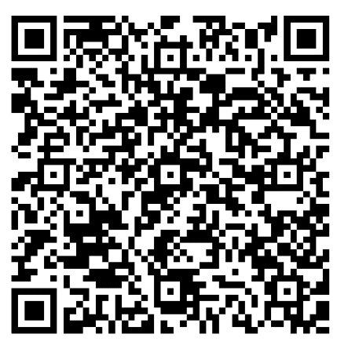
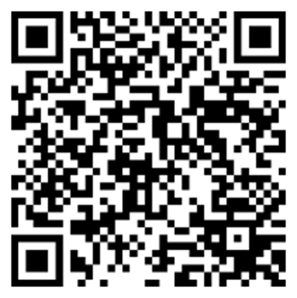
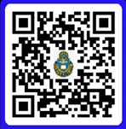
Sermon Notes
__________________________________________________________________________________________________________________________________________________________________________________________________________________
YOUTH GROUP: Samantha Odle leads the Youth Group at the Harrold Youth Center Tuesday at 6:00pm. For more information email: sodle@yfc.net
***SUNDAY SCHOOL TEACHERS NEEDED:
We need additional Sunday school teachers for 1-2 and 3-4 grades. Please see Carl Tillery.
DATE NIGHT: Commit to making your marriage a priority. Join us for the next Vertical Marriage Date Night on 07 November. Scan the QR code or call Jeff at 910-644-2999 for more information.
“TO GLORIFY GOD”
BRING IN | BUILD UP | SEND OUT
Ephesians 4: 17-32
19 October 2025
WELCOME TO CROSSROADS
It is our desire to connect with you and help you grow in Christ during your time at Fort Leavenworth. Scan the QR code and let’s grow together.
ADULT & CHILDREN’S SUNDAY SCHOOL 0945-1045.
Adult Class 1: Knowledge of the Holy, A.W.Tozer. Frontier Chapel, Room 158. Taught by Jim Harbridge.
Adult Class 2: Philippians: Christ, the Source of Joy and Strength. Frontier Chapel Rm 153 or Zoom Meeting ID 848 5837 0306. Paul urges believers to maintain their spiritual commitment and integrity and to continue to grow in Christ. Taught by Dr. Dean Nowowiejski
Adult Class 3: Book of 1 John, Room 150A, Frontier Chapel. Taught by Randy Klinger.
Adult Class 4: Power of a Praying Parent, Room 122, Frontier Chapel. Let’s learn how to pray scripture over our children and fight the battle for their hearts in prayer. Taught by Amanda Vineyard.
Young Adults: Christian Beliefs: 20 Basics Every Christian Should Know, by Wayne Grudem. Room 150B Frontier Chapel. Taught by Jeff Smith.
4 & 5 year olds Pioneer Chapel, Room 132
1st & 2nd grade Pioneer Chapel, Room 133
3rd & 4th grade Pioneer Chapel, Room 121
5th & 6th grade Pioneer Chapel, Room 119
7th & 8th grade Pioneer Chapel, Room 118
9th -12th grade Pioneer Chapel, Room 120
PWOC: Tuesday from 0830-1100 and 6:30-8:00pm at Frontier Chapel. Watch care and homeschool rooms provided at 0830 session.
OFFICERS’ CHRISTIAN FELLOWSHIP: The OCF Bible Study meets Tuesday from 0600-0700 at Pioneer Chapel’s Fellowship Hall. POC: Jim Harbridge, email: leavenworth@ocfusa.org
FAMILY NIGHT: Sunday, 26 October, from 5:30-7pm, we’ll have the next FAMILY NIGHT at Frontier Chapel. Please sign up after the service.
OPERATION CHRISTMAS CHILD SHOEBOX: We will have the shoeboxes available starting Sunday, 26 October. We will collect the shoeboxes on Sunday, 16 November.
Digital Giving - PGMN
Lord, strengthen me this week to pray specifically for:
1. __________________________
2. __________________________
Crossroads Staff
Pastor: CH Jared Vineyard - jared.l.vineyard.mil@army.mil
Education: Carl Tillery – carl.l.tillery.civ@army.mil
Music: Bob Isaac - sandbmusicflks@gmail.com
Youth: Samantha Odle - sodle@yfc.net
Facebook: Search ‘Crossroads Protestant Chapel’
Website: https://www.fortleavenworthchapel.org/

